Slide 1


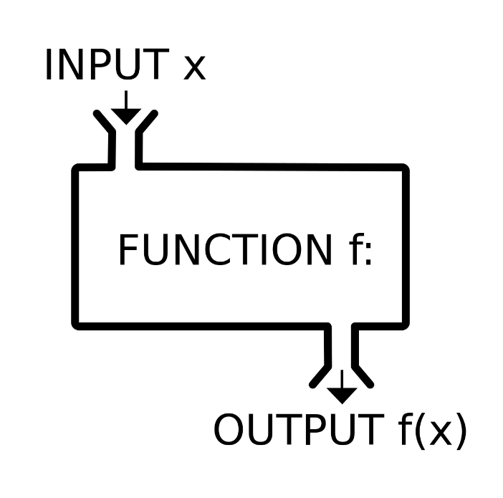


Data Types, Variables and Methods
Data Types and Type Conversion
Using different methods
Programming Fundamentals
SoftUni Team
Technical Trainers
Software University
http://softuni.bg

Slide 2



Table of Contents
Integer Types
Real Number Types
Other Data Types

Slide 3
Have a Question?
sli.do #fund-softuni

Slide 4
Integer Types
byte
sbyte
uint
short
int
ushort
long
ulong

Slide 5
Integer Types
sbyte [-128 …127]: signed 8-bit [-2⁷ … 2⁷-1]
byte [0 … 255]: unsigned 8-bit [0 … 2⁸-1]
short [-32 768 … 32 767]: signed 16-bit [-2¹⁵ … 2¹⁵-1]
ushort [0 … 65 535]: unsigned 16-bit [0 … 2¹⁶-1]
int [-2 147 483 648 … 2 147 483 647]: signed 32-bit [-2³¹ … 2³¹-1]
uint [0 … 4 294 967 295]: unsigned 32-bit [0 … 2³²-1]
long [-9 223 372 036 854 775 808 … 9 223 372 036 854 775 807]: signed 64-bit [-2⁶³ … 2⁶³-1]
ulong [0 … 18 446 744 073 709 551 615]: unsigned 64-bit [0 … 2⁶⁴-1]
byte
sbyte
uint
short
int
ushort
long
ulong

Slide 6

Centuries – Example
Depending on the unit of measure we can use different data types:
byte centuries = 20; // A small number (up to 255)
ushort years = 2000; // A small number (up to 32767)
uint days = 730484; // A large number (up to 4.3 billions)
ulong hours = 17531616; // A very big number (up to 18.4*10^18)
Console.WriteLine( "{0} centuries = {1} years = {2} days = {3} hours.", centuries, years, days, hours);

Slide 7
Beware of Integer Overflow!
Integers have range (minimal and maximal value)
Integers could overflow → this leads to incorrect values
byte counter = 0;
for (int i = 0; i < 260; i++)
{
counter++;
Console.WriteLine(counter);
}
1
2
…
255
0
1

Slide 8
Problem: Integer Types
Write program that receives 4 integers and prints them, on a single line, separated by spaces.
The 1st one will be in range [0, 255].
The 2nd one will be in range [0, 2³¹].
The 3rd one will be in range [-2³¹, 2³¹ - 1].
The 4th one will be in range [-2⁶⁴, 2⁶⁴ – 1].
Use the appropriate integer data types for this problem.
Check your solution here: https://judge.softuni.bg/Contests/Practice/Index/842#0

Slide 9
Solution: Integer Types
byte first = byte.Parse(Console.ReadLine());
uint second = uint.Parse(Console.ReadLine());
int third = int.Parse(Console.ReadLine());
long fourth = long.Parse(Console.ReadLine());
Console.WriteLine($"{first} {second} {third} {fourth}");
Check your solution here: https://judge.softuni.bg/Contests/Practice/Index/842#0

Slide 10

Real Number Types
double
decimal
float
Floating-Point and Decimal Floating-Point Type

Slide 11

What are Floating-Point Types?
double
Floating-point types:
Represent real numbers, e.g. 1.25, -0.38
Have range and precision depending on the memory used
Sometimes behave abnormally in the calculations
May hold very small and very big values like 0.00000000000001 and 10000000000000000000000000000000000.0
float

Slide 12
Floating-Point Numbers
Floating-point types are:
float (±1.5 × 10⁻⁴⁵ to ±3.4 × 10³⁸)
32-bits, precision of 7 digits
double (±5.0 × 10⁻³²⁴ to ±1.7 × 10³⁰⁸)
64-bits, precision of 15-16 digits
The default value of floating-point types:
Is 0.0F for the float type
Is 0.0D for the double type
double
float

Slide 13
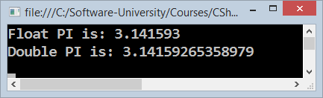
PI Precision – Example
Difference in precision when using float and double:
NOTE: The "f" suffix in the first statement!
Real numbers are by default interpreted as double!
One should explicitly convert them to float
float floatPI = 3.141592653589793238f;
double doublePI = 3.141592653589793238;
Console.WriteLine("Float PI is: {0}", floatPI);
Console.WriteLine("Double PI is: {0}", doublePI);

Slide 14
Rounding Floating-Point Numbers
Math.Round(3.45) – round to integer number (mathematically)
Math.Round(2.3455, 3) – round with precision
Math.Ceiling() – round up to the nearest integer
Math.Floor() – round down to the nearest integer
Banker's rounding:
2.5 → 3
3.5 → 4
3.45 → 3
double a = 2.3455;
Console.WriteLine(Math.Round(a)); // result: 2
Console.WriteLine(Math.Round(a, 3)); // result: 2.346
Console.WriteLine(Math.Ceiling(a)); // result: 3
Console.WriteLine(Math.Floor(a)); // result: 2
Notes:
Goes to notes

Slide 15
Scientific Notation
Floating-point numbers can use scientific notation, e.g.
1e+34, 1E34, 20e-3, 1e-12, -6.02e28
double d = 10000000000000000000000000000000000.0;
Console.WriteLine(d); // 1E+34
double d2 = 20e-3;
Console.WriteLine(d2); // 0.02
double d3 = double.MaxValue;
Console.WriteLine(d3); // 1.79769313486232E+308

Slide 16
Floating-Point Division
Integral division and floating-point division are different:
Console.WriteLine(10 / 4); // 2 (integral division)
Console.WriteLine(10 / 4.0); // 2.5 (real division)
Console.WriteLine(10 / 0.0); // Infinity
Console.WriteLine(-10 / 0.0); // -Infinity
Console.WriteLine(0 / 0.0); // NaN (not a number)
Console.WriteLine(8 % 2.5); // 0.5 (3 * 2.5 + 0.5 = 8)
int d = 0; // Integral division works differently
Console.WriteLine(10 / d); // DivideByZeroException

Slide 17

Floating-Point Calculations – Abnormalities
Sometimes floating-point numbers work incorrectly!
Console.WriteLine(100000000000000.0 + 0.3);
// Result: 100000000000000 (loss of precision)
double a = 1.0f, b = 0.33f, sum = 1.33;
Console.WriteLine("a+b={0} sum={1} equal={2}",
a+b, sum, (a+b == sum));
// a+b=1.33000001311302 sum=1.33 equal=False
double one = 0;
for (int i = 0; i < 10000; i++) one += 0.0001;
Console.WriteLine(one); // 0.999999999999906

Slide 18

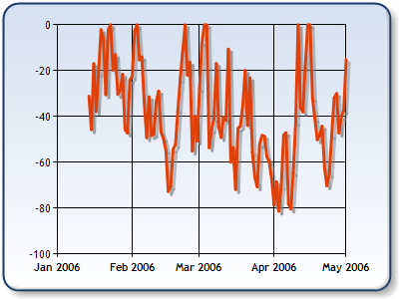
Decimal Floating-Point Type
There is a special decimal floating-point real number type in C#:
decimal (±1,0 × 10⁻²⁸ to ±7,9 × 10²⁸)
128-bits, precision of 28-29 digits
Used for financial calculations
Almost no round-off errors
Almost no loss of precision
The default value of decimal type is:
0.0M (M is the suffix for decimal numbers)
decimal
Notes:
Text goes to notes

Slide 19
Problem: Real Number Types
Write program that receives 2 lines of input.
On the 1st line you will receive N – the count of digits after the decimal point.
On the 2nd line you will receive a number.
Make sure you use the appropriate data type to hold that number.
N will be in range [0, 28]. The number will be in range [-2⁶⁴, 2⁶⁴].
Print the number after you read it.
Check your solution here: https://judge.softuni.bg/Contests/Practice/Index/842#1

Slide 20
Solution: Real Number Types
int n = int.Parse(Console.ReadLine());
if(n < 16) Console.WriteLine(
double.Parse(Console.ReadLine()));
else if(n < 29) Console.WriteLine(
decimal.Parse(Console.ReadLine()));
Check your solution here: https://judge.softuni.bg/Contests/Practice/Index/842#1

Slide 21
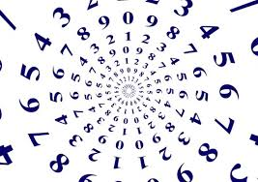
Other Number Data Types
BigInteger Structure

Slide 22
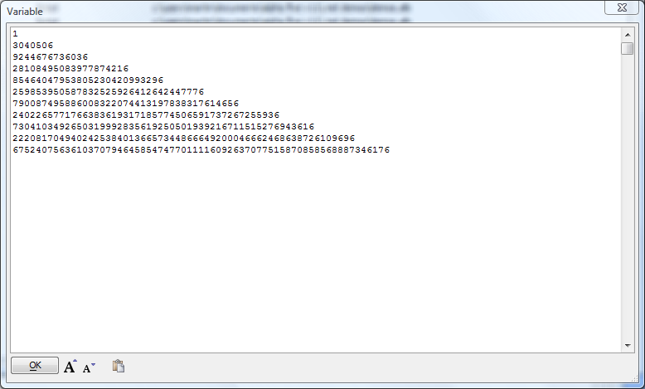
BigInteger Structure
BigInteger represents an arbitrarily large signed integer.
From the System.Numerics namespace.
Reference needs to be added.
Needs special methods for simple actions like adding, subtracting, multiplying, powering etc.

Slide 23
Problem: Big Power
Calculate n^n (n powered by itself) for very big n (e.g. 1000)
5
3125
10
10000000000
7596040312163297274222442578208043236112279041839441308045514203595638030283176823539793587591372230230103933110810192201741429
69
Check your solution here: https://judge.softuni.bg/Contests/Practice/Index/842#2

Slide 24
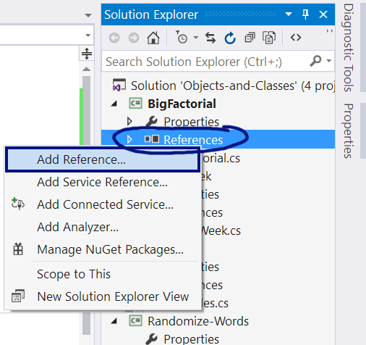
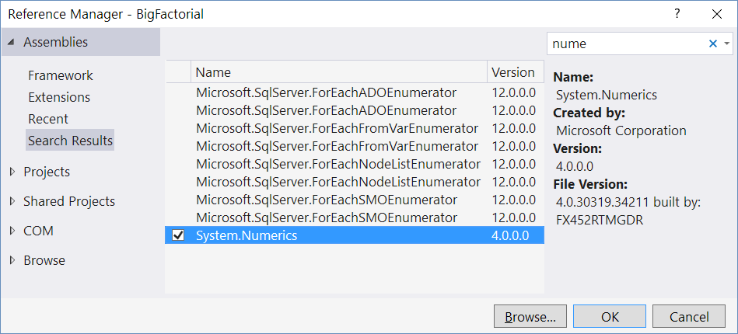
Solution: Big Power
Use the .NET API class System.Numerics .BigInteger
int n = int.Parse(Console.ReadLine());
Console.WriteLine(BigInteger.Pow(new BigInteger(n), n));
Check your solution here: https://judge.softuni.bg/Contests/Practice/Index/842#2

Slide 25

Summary
Number Types and Their Ranges
How to use the Math class methods.
How to use Real numbers.
What is the precision of the different Real Number Data Types.
How to work with very big numbers, which exceed normal number types.

Slide 26







Programming Fundamentals – Methods
https://softuni.bg/courses/programming-fundamentals

Slide 27
License
This course (slides, examples, demos, videos, homework, etc.) is licensed under the "Creative Commons Attribution-NonCommercial-ShareAlike 4.0 International" license

Slide 28





Trainings @ Software University (SoftUni)
Software University – High-Quality Education, Profession and Job for Software Developers
softuni.bg
Software University Foundation
http://softuni.foundation/
Software University @ Facebook
facebook.com/SoftwareUniversity
Software University Forums
forum.softuni.bg

